Slide 1

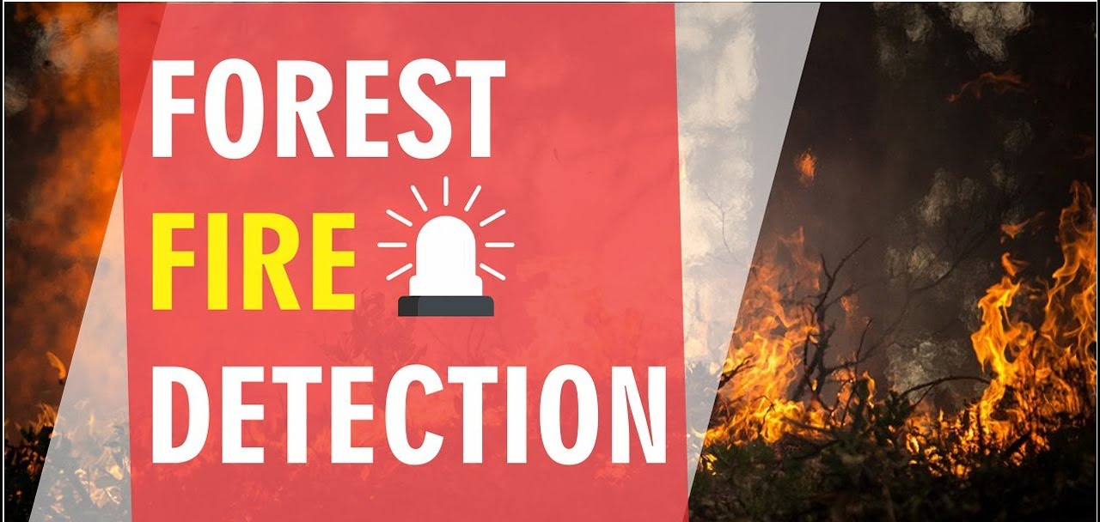
Forest fire recognition using AI
It recognizes whether there is forest fire if so sends an alert through mail
Done by :
priyanka chakraborty
N.Praneethchandra
S.Sai sujit
s.Sahithi
P.Puneeth anurag

Slide 2

Introduction
Forests are the protectors of earth's ecological balance.
Unfortunately, the forest fire is usually only observed when it has already spread over a large area, making its control and stoppage arduous and even impossible at times.
The result is devastating loss and irreparable damage to the environment and atmosphere (30% of carbon dioxide (CO₂) in the atmosphere comes from forest fires) [1], in addition to irreparable damage to the ecology (huge amounts of smoke and carbon dioxide (CO₂) in the atmosphere).
Among other terrible consequences of forest fires are long-term disastrous effects such as impacts on local weather patterns, global warming, and extinction of rare species of the flora and fauna.
The objective is to detect the fire as fast as possible and its exact localization and early notification to the fire units is vital.
This is the deficiency that the present Invention attempts to remedy, by means of detection of a forest fire at the very early stage, so as to enhance or ensure the chance to put it out before it has grown beyond control or causes any significant damage.

Slide 3

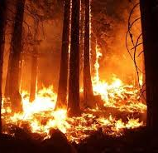
Effects of forest fire
loss of valuable timber resources.
degradation of catchment areas.
loss of biodiversity and extinction of plants and animals.
loss of wildlife habitat and depletion of wildlife.
loss of natural regeneration and reduction in forest cover.
global warming.

Slide 4
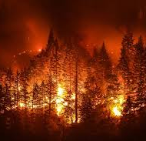
Uses of forest fire detection
Areas destroyed by these fires are large and produce more carbon monoxide than the overall automobile traffic.
Monitoring of the potential risk areas and an early detection of fire can significantly shorten the reaction time and also reduce the potential damage as well as the cost of fire fighting

Slide 5

Thank You!
someone@example.com

